Slide 1
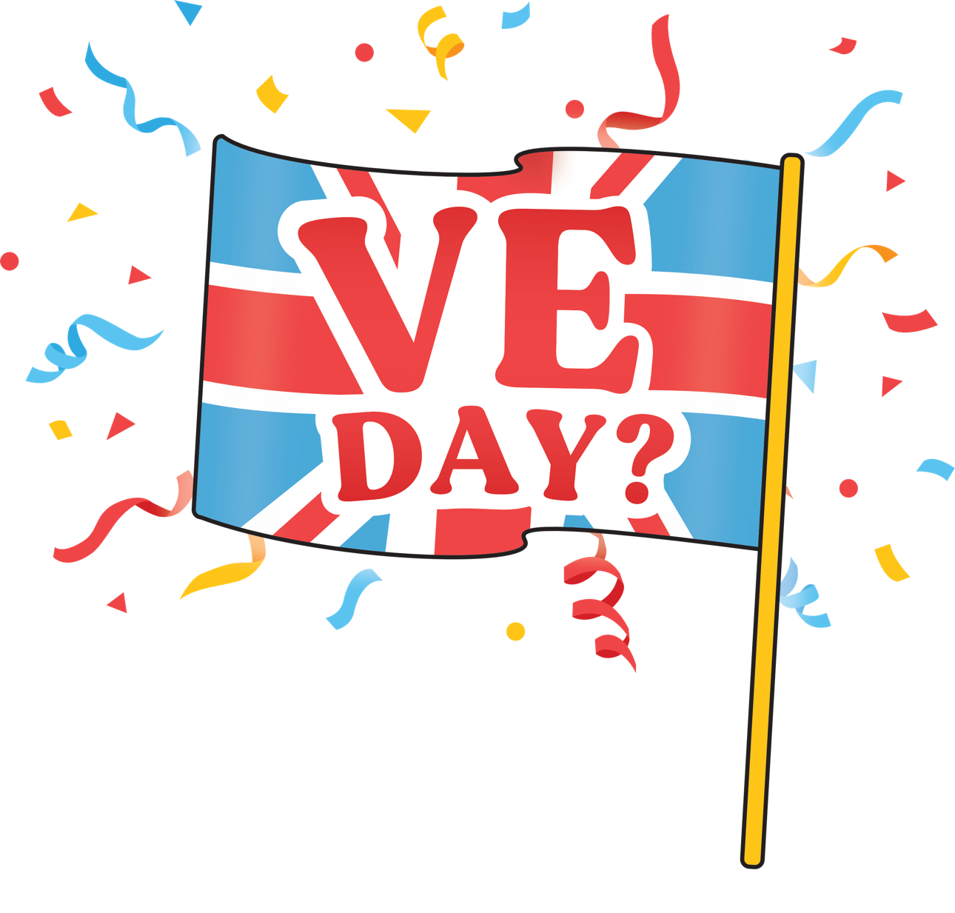
Why do we celebrate VE Day?

Slide 2
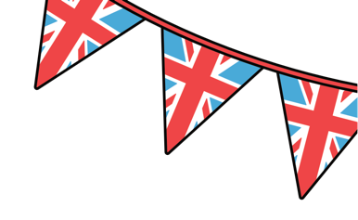
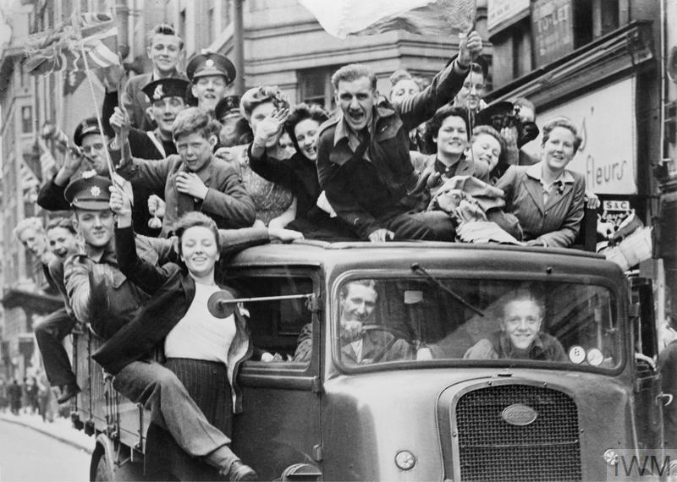
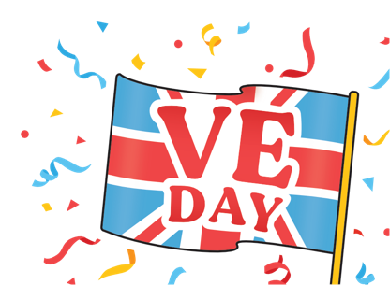
What do you think might be happening in this photo?
© IWM (HU 41808)

Slide 3
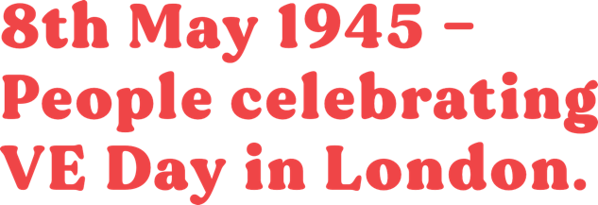
8th May 1945 – People celebrating VE Day in London
VE stands for Victory in Europe.
On this day, the Allied armies accepted the unconditional surrender of Nazi Germany's armed forces – ending World War 2
in Europe.
© IWM (HU 41808)

Slide 4
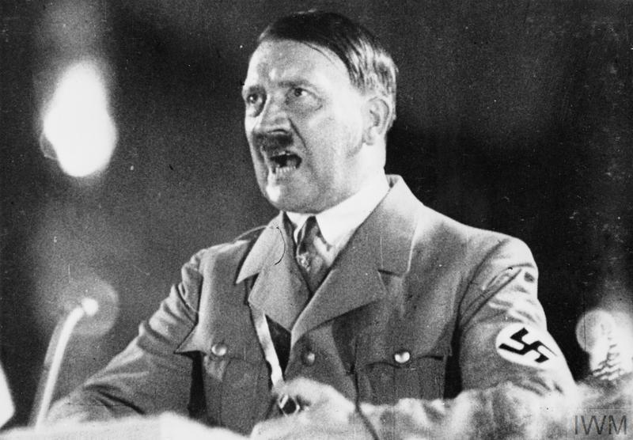
What was World War 2?
© IWM (MOI) FLM 1531
World War 2 was a global conflict that took place from 1939 to 1945.
It involved many countries around the world, including Britain.
The war began when Germany, led by
Adolf Hitler, invaded Poland in
September 1939.

Slide 5
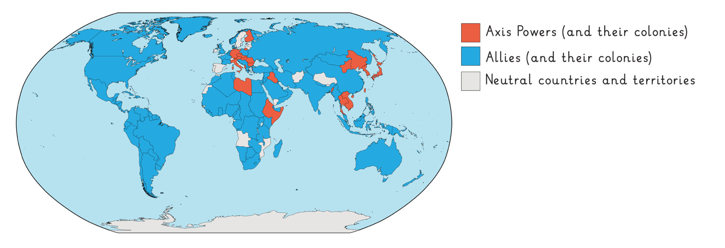
What was World War 2? Part 2
The invasion of Poland sparked a series of alliances and declarations of war.
Many nations were drawn into the conflict.
The war was fought between two major alliances: the Allies, which included Britain, the United States, and the Soviet Union, and the Axis powers, led by Germany, Italy, and Japan.

Slide 6
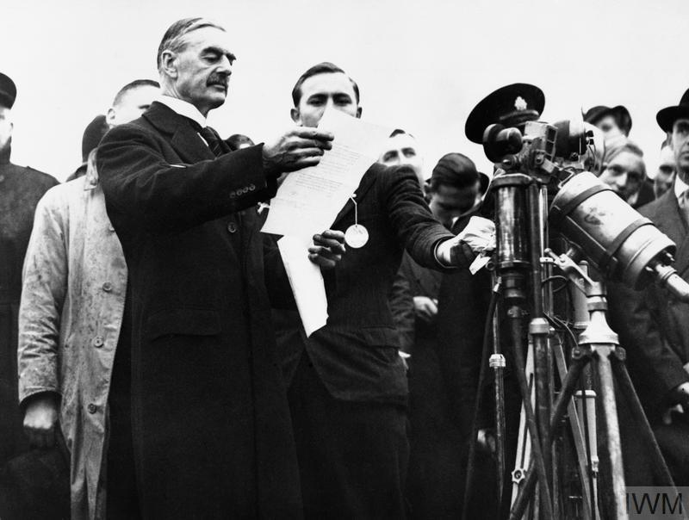
Britain’s role in WW2
© IWM HU 4255
In the years leading up to World War II, tensions were rising across Europe.
Adolf Hitler, the leader of Germany, had been expanding his power and influence by taking over neighbouring territories such as Austria and the Czechoslovak Republic.
The British government, under Prime Minister Neville Chamberlain, hoped to avoid another war, so agreed to let Germany take this land if they promised not to take any more.
Neville Chamberlain, in 1938, holding a piece of paper that he and Adolf Hitler had signed. On it was the quote, “a desire never to go to war again.”

Slide 7
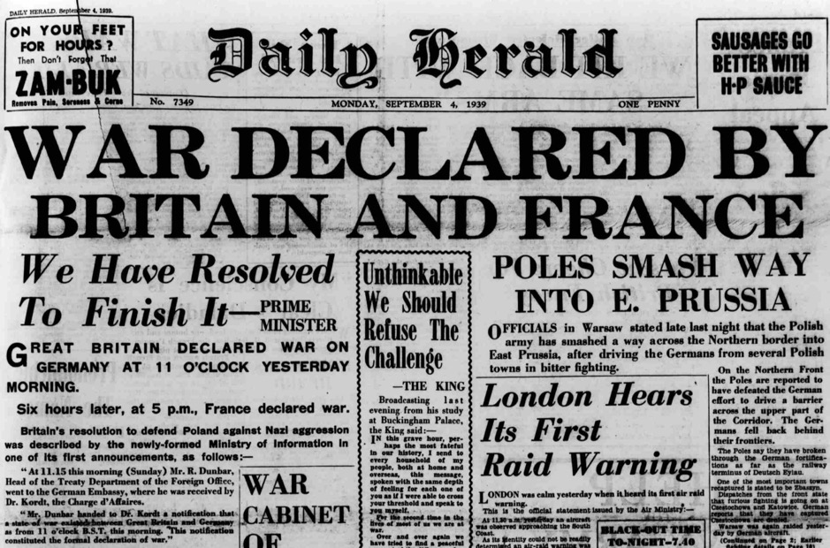
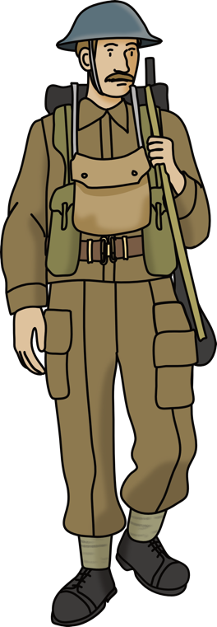
Britain’s role in WW2 – part 2
On September the 3rd 1939, Germany invaded Poland.
The British government sent a letter demanding that Germany withdraw its troops from Poland.
© British Newspaper Archive
It warned that if they did not, Britain would ‘fulfil its obligations to Poland’. This was quickly rejected and Britain declared war on Germany.
Just over 20 years after the end of World War 1, Britain was at war once again.

Slide 8
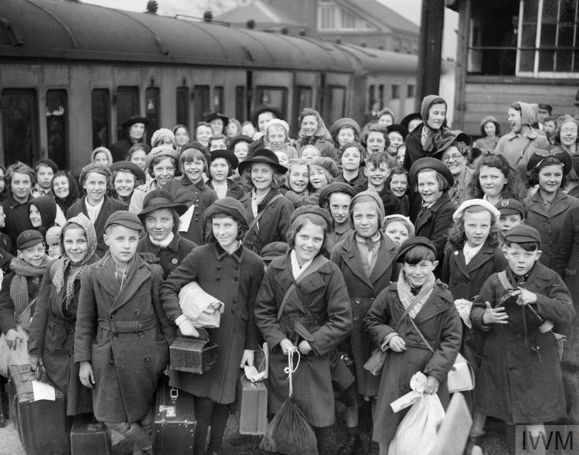
Evacuation in Britain
© IWM (D 2587)
During the War, over a million children and mothers with babies, living in cities, were sent to live with host families in the countryside.
Most evacuated children had returned home well before VE day.

Slide 9
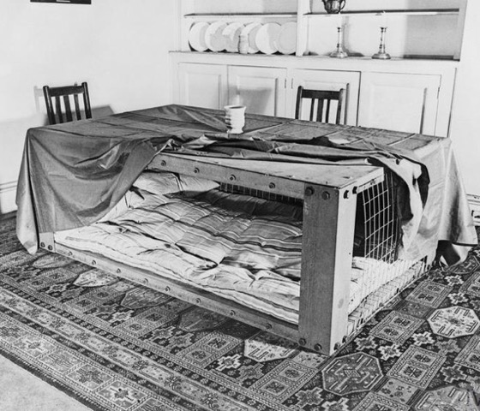
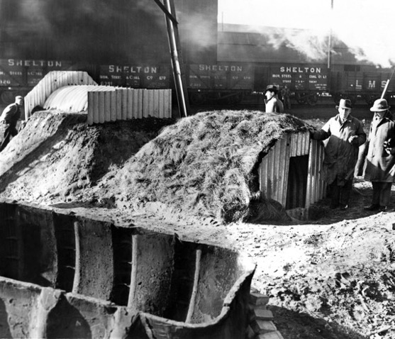
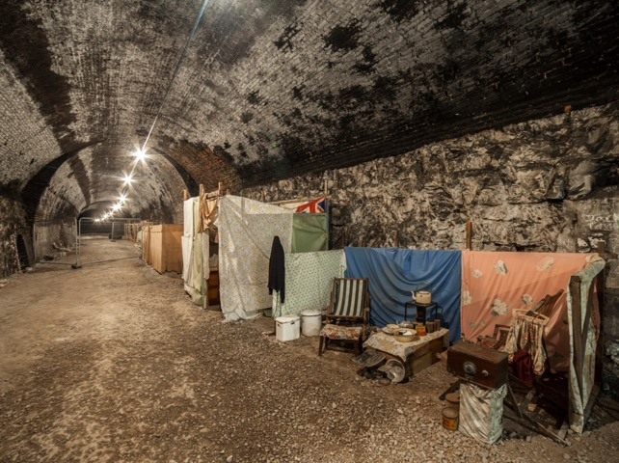
Preparing for attacks
Anderson shelters were designed to be built in people’s gardens and covered in soil for extra protection.
Many towns and cities had public air raid shelters that could provide a place of refuge for hundreds or even thousands of people.
© IWM (D 2053
Morrison shelters were not as popular as Anderson shelters. They were a metal cage that would protect the people inside if the building collapsed.

Slide 10
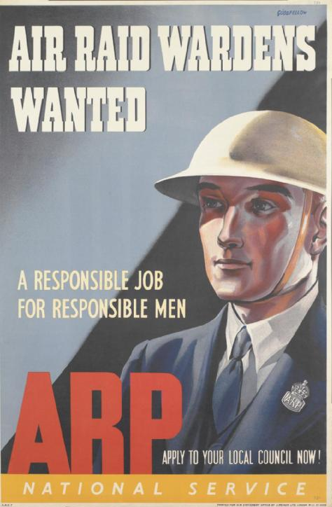
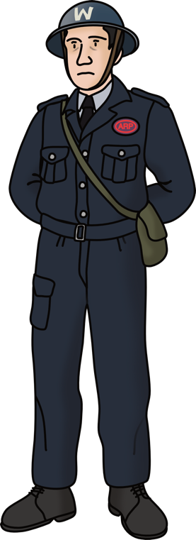
Air raid wardens
To make it harder for German bombers to locate buildings at night, all windows had to be covered with heavy curtains, cardboard or paint so no light could escape.
© IWM (Art.IWM PST 13881)
This was called the blackout.
ARP (Air Raid Precautions) wardens would make sure that the blackout was being carried out properly.
They also sounded the warning sirens, guided people to public shelters, issued and checked gas masks, rescued people from bombed out buildings and found places to stay for those who had lost their homes.

Slide 11
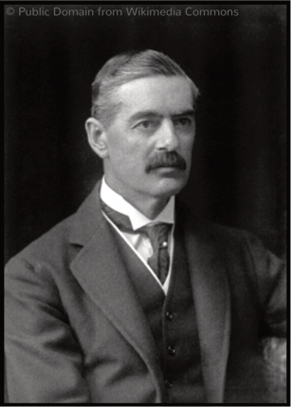
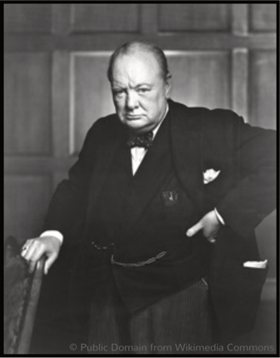
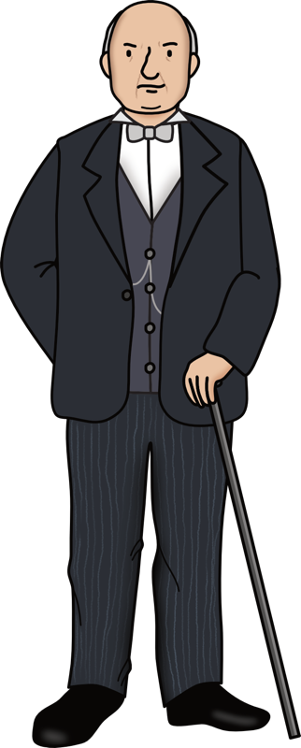
A change of Prime Minister
For the first 8 months of World War 2, there was very little actual warfare as both
sides planned and prepared for war. This period of time was known as the Phoney War.
© National Portrait Gallery, London (NPG x166506)
Neville
Chamberlain
Prime Minister from
28th May 1937
– 10th May 1940
Winston
Churchill
Prime Minister
from 10th May
1940 – 26th
July 1945
© National Portrait Gallery, London (NPG x166506)
On the 10th of May 1940, the Phoney War came to an end as German troops marched into Belgium, the Netherlands and Luxembourg, marking the start of the Battle of France. On this day, Neville Chamberlain was replaced by Winston Churchill, who became the new Prime Minister.

Slide 12
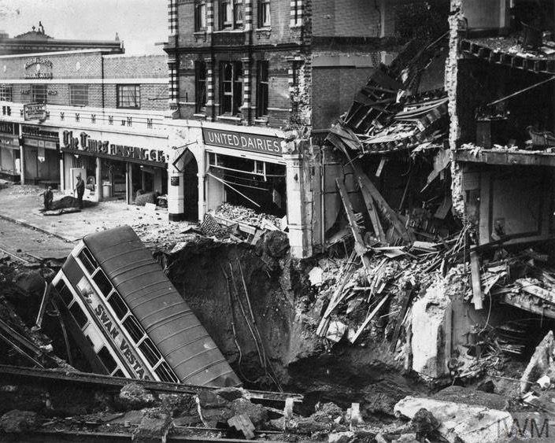
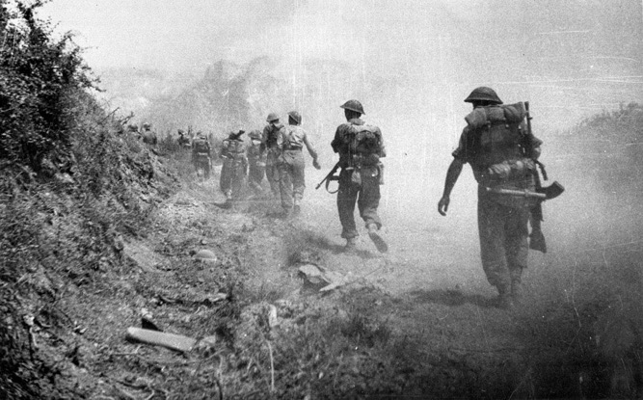
Around the world
Millions of people around the world died
– more than in any other war. Thousands
of them were from Britain.
Some died or were badly injured while fighting for their country overseas.
In Britain the worst bombing was between 1940 and 1941 during the Blitz.
Monte Cassino, Italy
Warrington, England

Slide 13
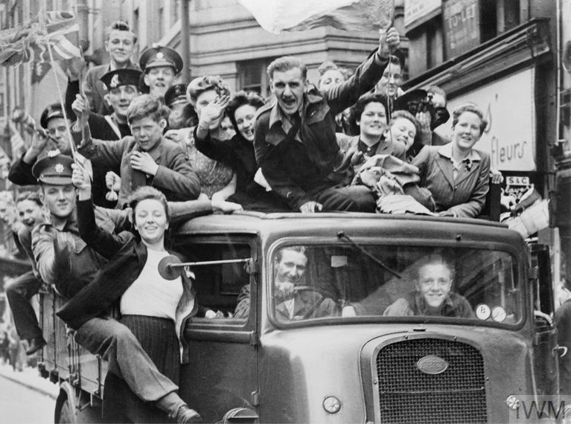
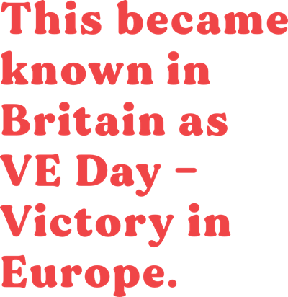
Hitler and the Nazi’s surrender
On 8th May 1945 Hitler and the Nazis surrendered.
That means they agreed to stop fighting and to end the war.
The terrible war was over in Europe.
© IWM (HU 41808)

Slide 14
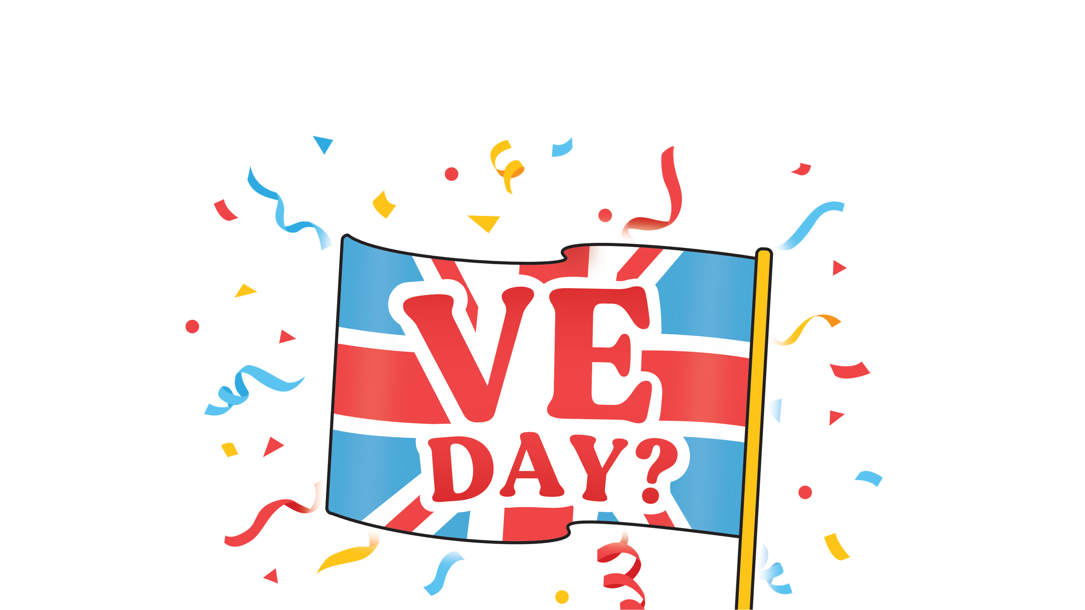
Why do we celebrate VE Day? The End

